Slide 1
Managing Service Experiences
Chapter 6

Slide 2
Why care about experiences?
Battle for the “eyeballs”
Increased customer loyalty
Increased focus on experience for product and services
  Product Purchase Process = Experience Service:
    Experience over convenience: Coke in Japan
    Try and buy: Xscape Mall in UK and Europe
  Hospitality, retail, entertainment, education, websites, and many other industries

Slide 3
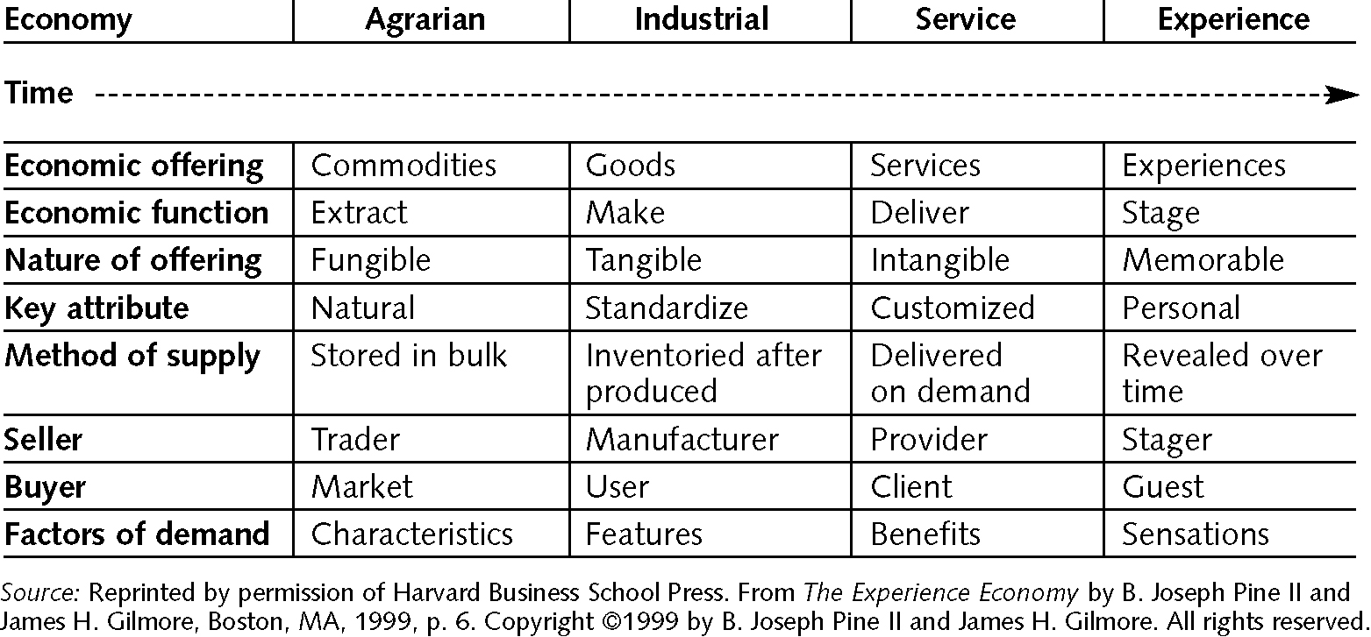
Pine and Gilmore’s
Economic Progression

Slide 4
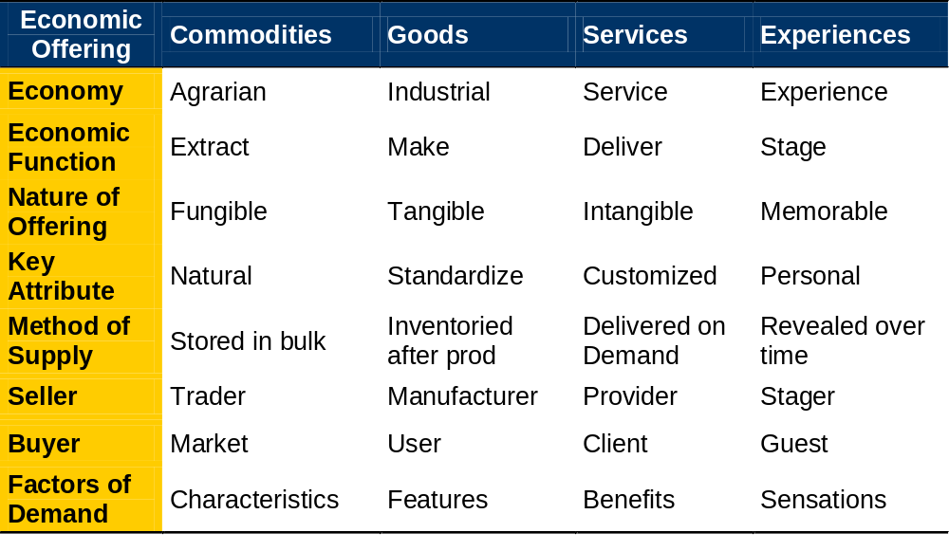
Economic Progression (Pine & Gilmore, 1998)

Slide 5
What does it take to create an experience for customers?
What do you consider an experience?
What creates memorable experience (i.e., pleasure, pain, or extreme challenge)?
What creates an experience at a mass venue (mall, theme park, concert, or theatre)?
What creates customised experiences?
What resources are needed to create these experiences?

Slide 6
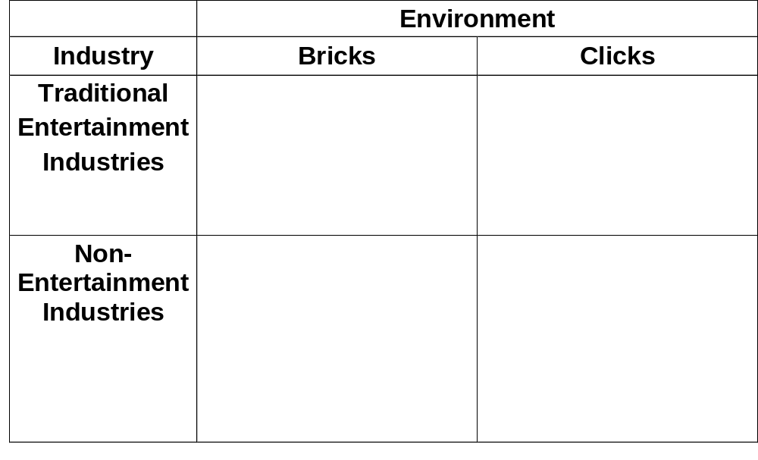
Demand for Experiences & Implications
Increased Capital Expenditures
  theatres
  theme parks
  film & TV
Migration of content
Digital revolution & website overload
2D > 3 D issues
Interactive with TV
Bandwidth
Increase emphasis on experience design
Increased demand for
  New experiences
  Eatertainment
  Edutainment
  Themed Hotels, Malls, & Restaurants (Shoppertainment)
  Try & Buy Retail
Increased emphasis on experience design
More challenging to create a
rich and memorable
experience

Slide 7
World Experience Business
Economic Drivers
Customer Loyalty over satisfaction
International Opportunities
Supply & Barriers to Entry
Universal Appeal
Technology
Long term customers

Slide 8
Relational Model of Managed Customer Service
Process
Outcome
Service Provider
Customer
Memory
Context
Engagement
Time
Loyalty

Slide 9
Engagement
Personal level
  Active: customers affect the performance or event (skiing or golf)
  Passive: customers do not influence the performance
Environment
  Immersion: customer “goes into” the experience (Mist computer game or Club Med skit)
  Absorption: Experience “goes into” the customer (watching TV)

Slide 10
Examples
 |  | Environment Relationship
 |  | Absorption | Immersion
Participation | Passive | Entertainment Television Circus Theatre Video/DVD | Esthetic Grand Canyon Cathedral Bellegio Water Show
 | Active | Educational Training Discussion Laboratory | Escapist Mist Computer game Terminator 2 Ride Chat rooms

Slide 11
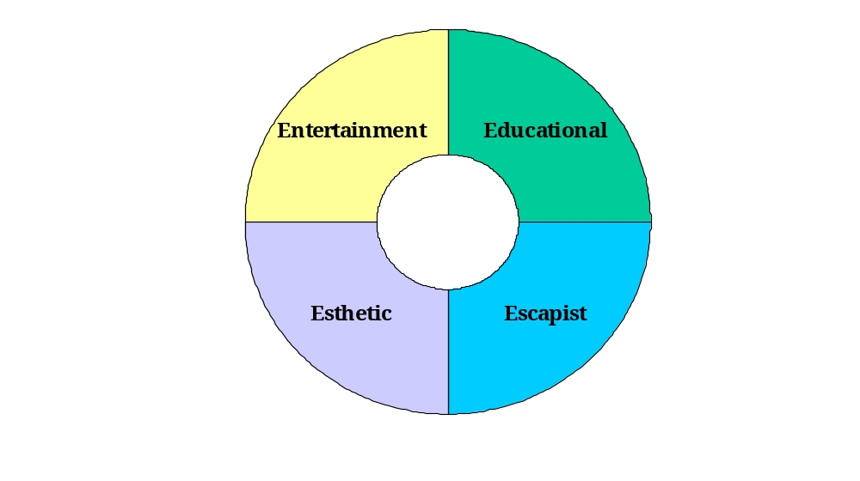
Realms of Experience
Absorption
Passive
Participation
Sweet Spot
Active
Participation
Immersion

Slide 12
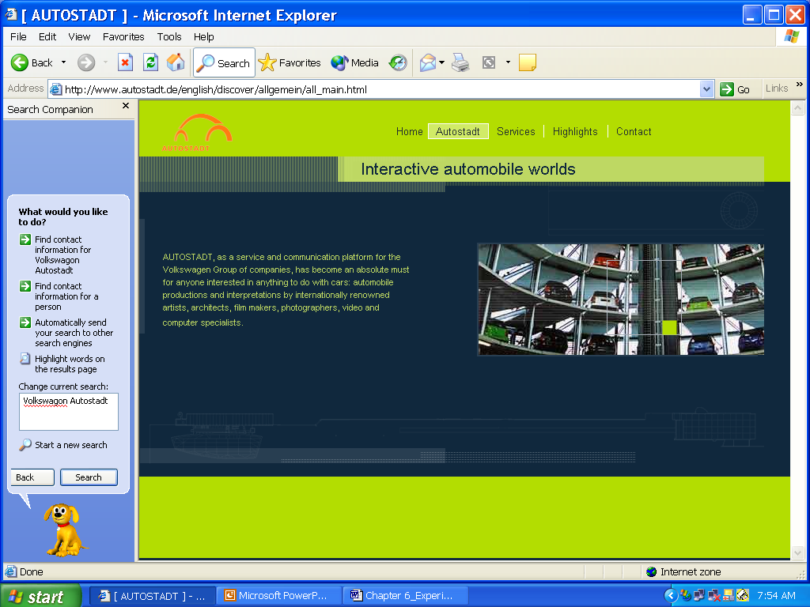
Retailment or Shoppertainment

Slide 13
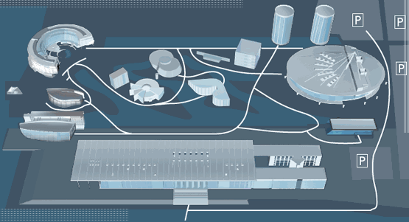
Autostadt
$400 million, 62-acre factory/car dealership/theme park in Wolfsburg, Germany

Slide 14
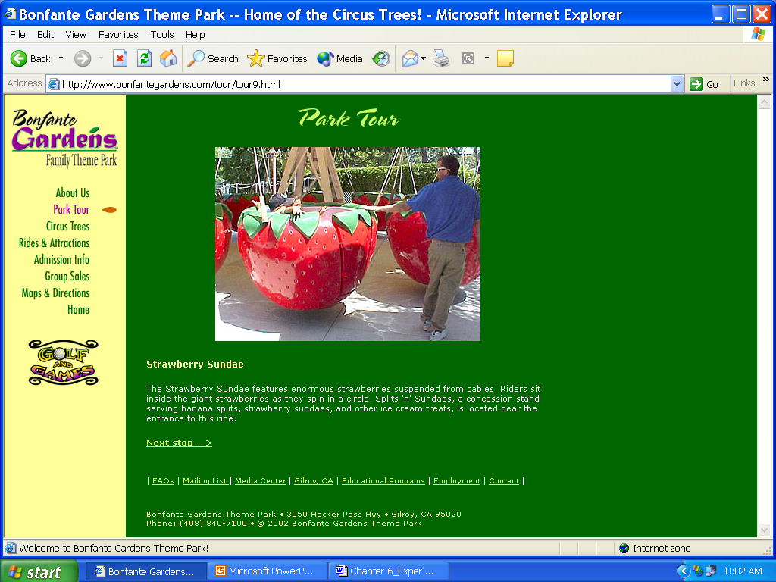
Edutainment:
Bonfante Gardens, Gilroy, CA.
™ ® © 2004 Bonfante Gardens Family Theme Park. All Rights Reserved.

Slide 15
Context
Where customers consume the service and everything they interact with in that setting.
Starbucks “contemporary bohemian” context
Relational elements
Physical elements

Slide 16
Relational Context
Theme: unifying story or metaphor
Learnable and Usable
Mutable: flexibility for customers to create their own use environment or personal experience

Slide 17
Theme Generation
Joie de Vivre: 18 themed Boutique Hotels in Bay Area
Method: Take a magazine and generate 5 adjectives to describe it and the people that would read it. Design hotel experience around those words.

Slide 18
Theme Generation
Example: Hotel Rex = New Yorker
  Worldly, sophisticated, literate, artistic, & clever
  Designed like an arts and literary salon of 1930s. Clubby lobby with period furnishings, paintings, and old books. Rooms have local artists paintings and contemporary amenities.

Slide 19
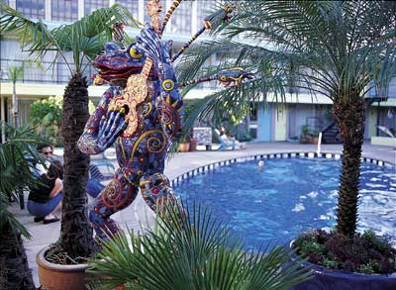
Theme Rolling Stone
Funky, hip, young-at-heart, irreverent, and adventurous
The Phoenix Hotel has been popular with the entertainment industry for over a decade. This funky, urban retreat is an unexpected oasis, featuring a landmark pool, original 50s architecture, and island-inspired guestrooms. Backflip, the hotel's poolside cocktail lounge, is drenched in glamorous bachelor pad style and the music of the City's most progressive DJ's.

Slide 20
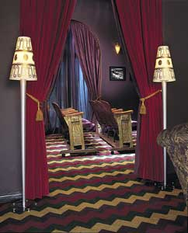
Theme Movie Line
Dramatic, nostalgic, fun-loving, classic, and informal
Each light and comfortable guestroom is named for a motion picture shot in San Francisco, with original movie stills as decorative room accents

Slide 21
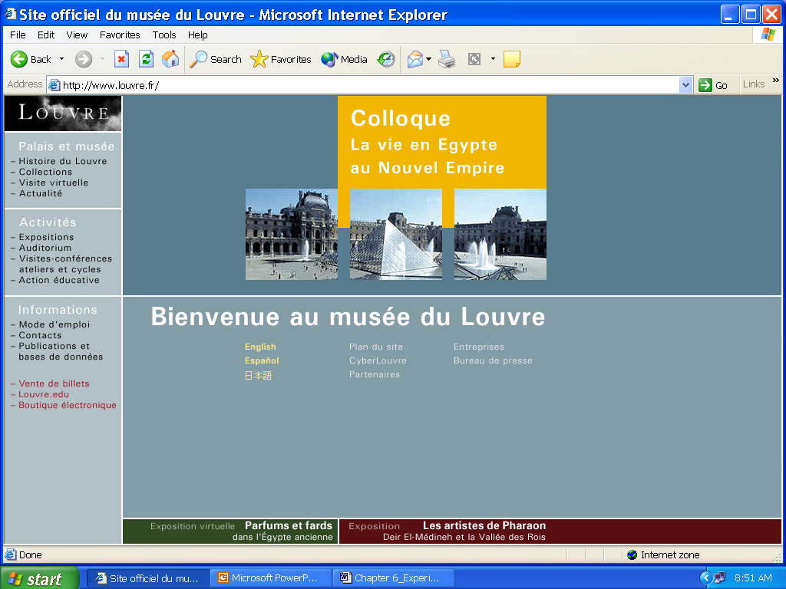
Learnable and Usable

Slide 22
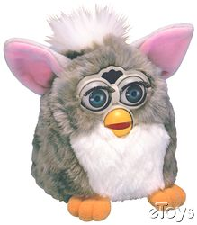
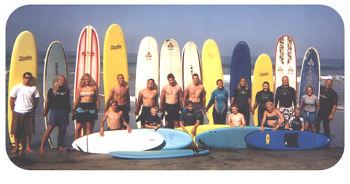
Mutability
Furby
Groundswell Surf Camp
  Surfing instruction for all ages in a surf camp environment

Slide 23
Physical
Layout: Physical layout and arrangement of objects (should encourage active participation) and reinforce theme
Sensory: Sensory elements increase immersion and support theme (T-2)
Social Interaction: Interaction between guest and service provider and/or fellow guests. Increases identification with service (Club Med and Cirque Du Soleil)

Slide 24
Sensory
Smell
Taste
Touch
Sound
Sight
  Cirque Du Soleil (“O”), T-2 Ride, W Hotels, and IMAX Theaters.
  See www.ideo.com

Slide 25
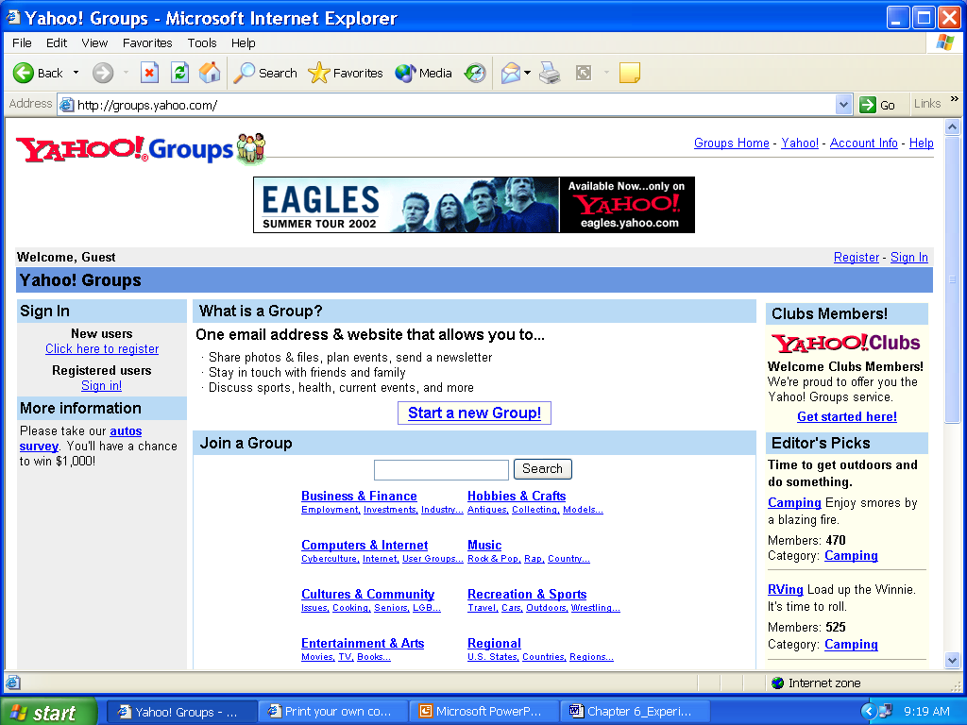
Social Interaction Yahoo Groups

Slide 26
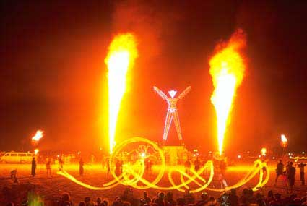
Social Interaction - Burning Man Event
Photo by David L. Newsom

Slide 27
Time
Memorabilia
  Is a physical reminder of experience, extends memory of it long after
  Generates dialogue about experience
  Provides additional revenue
Continuity
  Time aspects of experience as it relates to the individual (bonding and moving through stages)

Slide 28
Time
Dynamic
  A desirable pattern for experiences revealed over a specific time frame
    Long or short term vs. intensity
    A script or music score
    NOLS or Outward Bound

Slide 29
Creating the Process of Customer Experience
PHYSICAL
Theme – Layout – Sensory
Increase Physical Interaction
& Cognition
RELATIONAL
Learnable – Usable – Mutable
Social – Interaction
Increase Emotion & Cognition
CONTEXT
Increase
COMMITMENT & LOYALTY
ENGAGEMENT
TIME
Educational
Escapist
ACTIVE
Continuity
Dynamic
Entertainment
Esthetic
Memorabilia
PASSIVE
ABSORBTION
IMMERSION

Slide 30
Example: Themed Restaurant Successful & Failed Experiences
Dimension | Hard Rock Café | Planet Hollywood
Engagement: Entertainment & Food Move from passive to active Move from absorption to immersion Get guests to stay/return Make experience fun Connect emotionally with customers Increase thrill, surprise, delight | Offers high quality American diner/pub food Has 100 Cafes in 40 countries Appeals to international music enthusiasts Connects with irreverent, rebellious customer group Keeps the legends and adds new talent constantly Refreshes concept constantly and adds new features hardrock.com, performances, CDs, and Hotels | Offered low quality eclectic food, i.e., Cap’n Crunch chicken strips Had 80 restaurants predominately in US Appealed to celebrity seekers Connected with tourists (not locals) seeking stars when stars are available Depended on star availability at cafe Kept a stable of celebrity-stock holders who may or may not be in favor Difficult to refresh concept without constant major investments in hot stars Added concept with sports stars

Slide 31
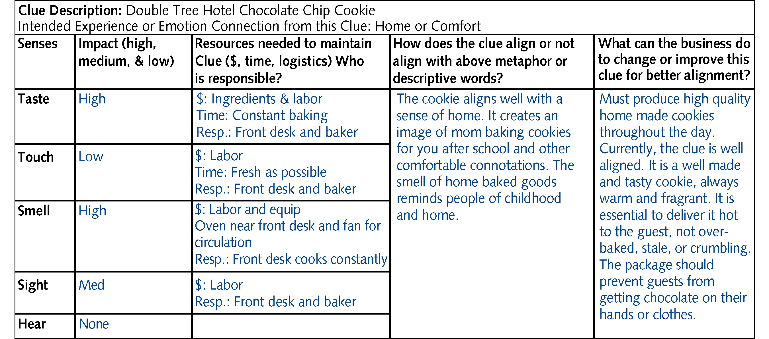
Clue Design for Double Tree Chocolate Chip Cookie

Slide 32
Chapter Summary
Creating experiences provides opportunities for new service innovations
The service designer is designing for experience just as the manager manages an environment for experience
The key dimensions of experience within management control include engagement, context, and time.

